Slide 1
South African National Seismograph Network (SANSN)
By Mr V. Jele

Slide 2
Communication

Slide 3
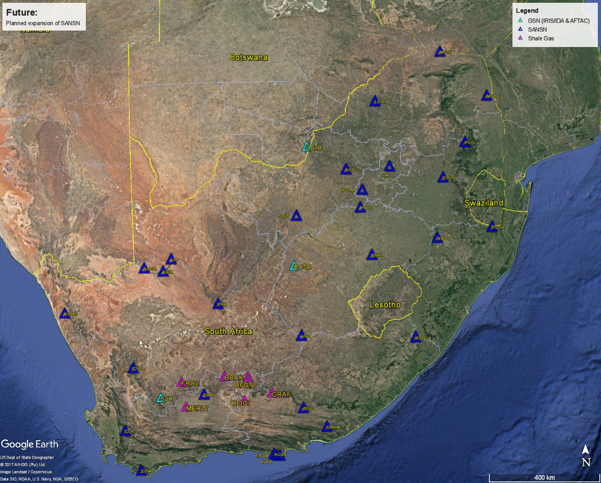

Slide 4
SANSN Instrumentation
SEISMOMETERS | NUMBER OF STATIONS WHERE THE TYPE OF SENSOR IS INSTALLED
REFTEK 151B-120 OBSERVER | 13
GURALP CMG 40T | 7
GURALP CMG 3T | 1
TRILLIUM 120 Q/QA | 7
STRECKEISEN STS-2 | 1
MARK PRODUCTS(SERCEL) L4-3D 1Hz | 6

Slide 5
SANSN Instrumentation
DIGITIZERS/DATALOGGER | NUMBER OF STATIONS WHERE THE TYPE OF SENSOR IS INSTALLED
EARTH DATA PS6-24 + SEISCOMP RECORDER | 15
QUANTERA Q330 SR | 7
QUANTERA Q330 HR | 1
NANOMETRICS CENTAUR2 | 8
EARTH DATA EDR209 | 3
REFTEK RT130 | 1

Slide 7
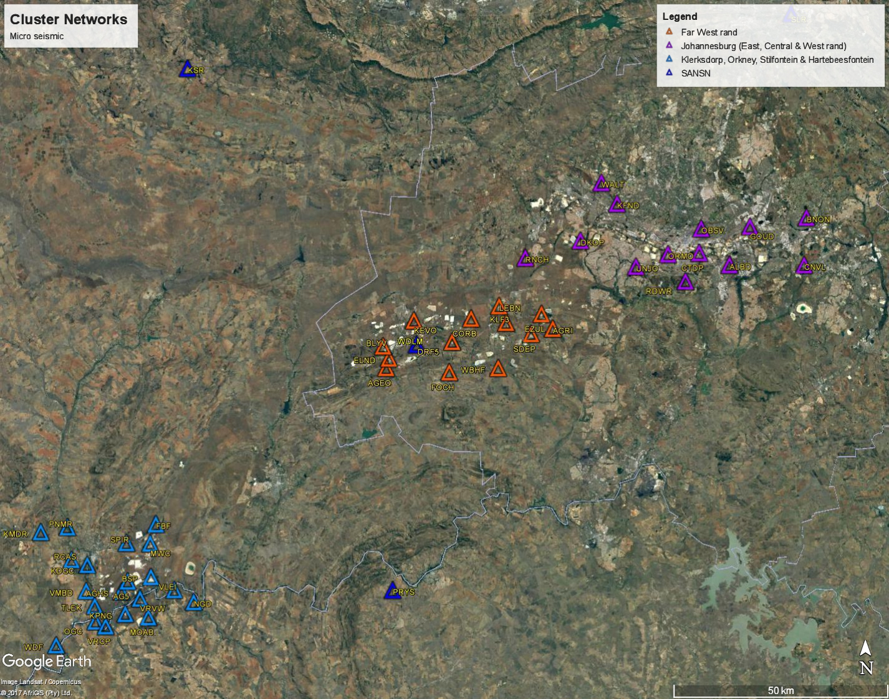

Slide 8
Cluster Network Instrumentation
SEISMOMETER/ACCELEROMETER | NUMBER OF STATIONS
EPISENSOR (ES-T) | 40
GURALP CMG 3ESP(120s) | 4
DIGITIZERS/DATALOGGER | NUMBER OF STATIONS
QUANTERA Q330 S+ | 44

Slide 9
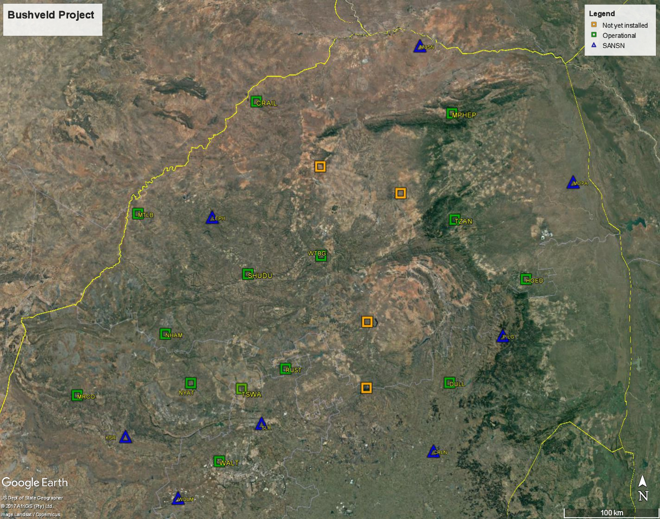
BUSHVELD-NETWORK

Slide 10
Bushveld Temporary Network Africa Array: WITS, Penn-State, CGS
SEISMOMETER | NUMBER OF STATIONS
STRECKEISEN STS-2 | 18
DIGITIZERS/DATALOGGER | NUMBER OF STATIONS
REFTEK RT130 | 18

Slide 11
Software
SeisComP3 (SANSN)
Data acquisition
Automatic processing
Waveform archiving
Seisan
Bulletin production
Antelope (Cluster Networks)
Data acquisition
Automatic and manual processing
Archiving
Other
RefTek (rtpd, rtpmonitor, rtcc)
Custom bash scripts

Slide 12
THANK YOU

